Slide 1
CHAPTER 4
Defining Scope, Quality, Responsibility, and Activity Sequence
© 2018 Cengage®. May not be scanned, copied or duplicated, or posted to a publicly accessible website, in whole or in part, except for use as permitted in a license distributed with a certain product or service or otherwise on a password-protected website or school-approved learning management system for classroom use.
Notes:
Teaching Strategies
The two vignettes reinforce consideration of the situation through research and communication with the stakeholders.
The first vignette addresses the changing conditions for project planning of worldwide construction projects due to weather variability and increased extreme weather situations.
The second examines a change in process for commerce. The desire was to increase credit card use; work with the stakeholders revealed a hesitation and distrust of credit cards due to potential fraud with an option for continued practices of e-commerce using debit cards. (See Premium Deck for Slides.)
Sometimes planning seems to be a waste of time for a short project. However, even very small projects need some degree of planning.
Tell the students a story of a failed project. Have students identify how having a clear project objective, a project scope document, a project plan, a work breakdown structure, a responsibility assignment matrix, and a network diagram could have changed the outcome.
Have students create a work breakdown structure and network diagram for a project they will have to complete during the class semester. Have the students explain the relationship between tasks that must be completed sequentially and those that can be completed simultaneously.
The network diagram for the consumer market study is included in the chapter materials. Have the students compare the textbook diagram with the one created in Microsoft Project. Have the students report on the similarities and the differences.
Optional Supplemental Activities
Recall that Chapter 1 offered an optional activity for student groups to contribute several hours to a not-for-profit organization. Have each group that participated in this activity give a 10 minute presentation and submit a 2-3 page write-up that discusses how that organization’s projects are planned, performed, controlled, and terminated. In addition, require each group to give at least 3 suggestions on ideas that could improve the projects at that organization.
Have students seek a project management mentor and report on their experiences related to developing the project scope and identifying the work breakdown structure.
Have students present an article from the International Journal of Project Management to the class. Have them post their critical review of the article to the class website, blog, wiki, or other class space to allow others to review and comment.

Slide 2
Chapter Concepts
Clearly defining the project objective
Preparing a project scope document
Understanding the importance of planning for quality
Creating a work breakdown structure
Assigning responsibility for work items
Defining specific activities
Creating a network diagram
Utilizing a project management methodology called the systems development life cycle for information systems development projects
Notes:
Chapter Concepts
This chapter discusses the project scope document, quality, how to define what activities need to be done, who will be responsible for them, and in what sequence they will be performed. It describes techniques and tools used to plan the work items and activities that need to be performed in order to accomplish the project objective successfully. The project scope defines what work needs to be done and what deliverables need to be produced. Then, specific activities are defined and arranged in a sequence of dependent relationships to determine how the work will be performed.
This chapter will help student to become familiar with:
Clearly defining the project objective
Preparing a project scope document
Understanding the importance of planning for quality
Creating a work breakdown structure
Assigning responsibility for work items
Defining specific activities
Creating a network diagram
Utilizing a project management methodology called the systems development life cycle for information systems development projects

Slide 3
Learning Outcomes
Establish a clear project objective
Prepare a project scope document
Discuss the importance and elements of a project quality plan
Develop a work breakdown structure
Prepare a responsibility assignment matrix
Describe how to define specific activities
Create a network diagram
Notes:
Learning Outcomes
After studying this chapter, students should be able to:
Establish a clear project objective
Prepare a project scope document
Discuss the importance and elements of a project quality plan
Develop a work breakdown structure
Prepare a responsibility assignment matrix
Describe how to define specific activities
Create a network diagram

Slide 4
Project Integration Management Project Scope Management Project Quality Management Project Resource Management Project Schedule Management
Project Management Knowledge Areas from PMBOK® Guide
Notes:
Project Management Knowledge Areas from PMBOK® Guide
Concepts in this chapter support the following Project Management Knowledge Areas of the PMI Guide to the Project Management Body of Knowledge (PMBOK® Guide):
Project Integration Management
Project Scope Management
Project Quality Management
Project Resource Management Project Schedule Management

Slide 5
Establish Project Objective
Planning process is based on the project objective
Establishes what is to be accomplished
Often stated in the project charter or RFP
Is the tangible end product
Project objective includes
Expected benefits
Primary project end product or deliverable
Date required to be completed
Budget
Changes agreed upon by customer and contractor
Notes:
Establish Project Objective
The planning process is based on the project objective.
The project objective establishes what is to be accomplished.
Often the project objective is stated in the project charter or RFP.
It is the tangible end product that the project team or contractor must produce and deliver in order for the sponsor or customer to achieve the expected benefits from implementing the project.
The project objective should include the following elements:
Expected benefits that will result from implementation of the project and define success
Primary project end product or deliverable
Date by which the project is required to be completed
Budget within which the project must be completed
Situations can arise where the project objective needs to be modified as the project proceeds because of extenuating circumstances or new information. The project manager and the customer must agree on all changes to the project objective. Any such changes might affect the remaining work scope, deliverables, completion date, and final cost.

Slide 6
Define Project Scope
Project Scope
Project Scope Document
Defines what needs done
Includes
Items contained in project charter, RFP, proposal
More detail
Establishes common understanding of scope with stakeholders
Usually contains
Customer requirements
Statement of Work
Deliverables
Acceptance Criteria
Work Breakdown Structure
Establishes baseline
Change control system to avoid scope creep
Notes:
Define Project Scope
The project scope defines what needs to be done.
A project scope document includes many of the items contained in the project charter, RFP, or contractor’s proposal, but in much greater detail. The document is valuable for establishing a common understanding among project stakeholders regarding the scope of the project.
The project scope document usually contains the following sections:
Customer requirements define the functional or performance specifications for the project’s end product and other project deliverables.
It should also include or reference applicable technical specifications, standards, and codes that must be used and met regarding quality and performance of the project work and deliverables.
Statement of Work (SOW) defines the major tasks that will need to be performed to accomplish the work that needs to be done and produce all the project deliverables.
Deliverables are the products or outputs that the project team or contractor will produce and provide to the customer during and at the completion of the performance of the project.
Acceptance criteria for all project deliverables must be described in greater detail than what is stated in the project charter or request for proposal
Work Breakdown Structure (WBS) is a hierarchical decomposition of the project work scope into work packages that produce the project deliverables.
The agreed-upon project scope document establishes the baseline for any changes that may be made to the scope during the performance of the project.
A change control system needs to be established to define how changes will be documented, approved, and communicated. The project team or contractor must avoid scope creep, which is informally making changes to the project scope without appropriate approval.

Slide 7
Plan for Quality
Complete work according to specifications and standards
Plan for assuring quality as project progresses
Include
References for specifications and standards
Written procedures for quality tools and techniques
Key aspects
Monitor as the project progresses
Do work right the first time rather than rework
Notes:
Plan for Quality
Planning for quality is a necessary, yet often forgotten or dismissed, function on a project. It is essential to have a plan for assuring the quality of project deliverables and results, rather than waiting until the end of the project to check if the sponsor/customer requirements and expectations on project deliverables have been met.
It is important to plan for quality in performing the project. This helps assure that the work is done according to specifications and applicable standards and that deliverables meet acceptance criteria.
A project quality plan includes or references:
Project specifications and standards
Industry or government standards (for design, testing, safety, construction, etc.)
Codes that must be used and met during the performance of the project work
Written procedures for using various quality tools and techniques
The key to quality control is to:
Monitor the quality of the work early and regularly throughout the performance of the project
Compare results with quality standards
Make any necessary corrective actions immediately, rather than waiting until all the work is completed before checking or inspecting for quality
To ensure that a project is done right the first time, a project should focus on doing the work in accordance with quality standards, and therefore preventing quality problems.

Slide 8
Create Work Breakdown Structure
Deliverable-oriented hierarchical decomposition
Organize project work and deliverables
Create logical groupings
Subdivide into more manageable components
Deliverable is output of work package
Resource requirements and durations can be assigned
Accountability can be assigned
Project manager can monitor and control
Graphic chart or indentured list
Notes:
Create Work Breakdown Structure
Once the project scope document has been agreed on and prepared, the next step in the planning phase is to create a detailed work breakdown structure (WBS)
This is a deliverable-oriented hierarchical decomposition of the project work scope into work packages, or activity groupings, that produce the project deliverables.
Creating a WBS is a structured approach for organizing all the project work and deliverables into logical groupings. This helps to subdivide the deliverables into more manageable components called work items, to help ensure that all tasks required to complete the project are identified and included in the baseline project plan.
The WBS should be deconstructed to a level that identifies individual work packages for each specific deliverable listed in the project scope document.
Dividing a project into work packages and work items helps a contractor increase the level of confidence that:
All the activities that need to be performed to produce the deliverable can be defined
The types and quantities of resources can be determined
The associated activity durations and costs can be reasonably estimated.
Work items should be broken down to the level at which a single organization (marketing communications, materials engineering, human resources, a subcontractor, etc.) or individual can be assigned responsibility and accountability for accomplishing the work package.
The WBS can be created using a graphic chart format or as a list.

Slide 9
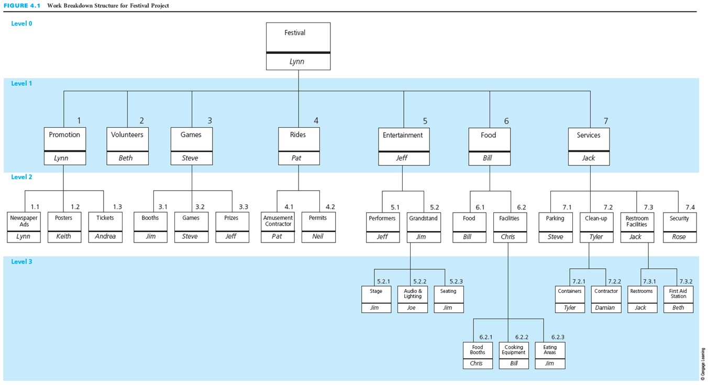
WBS with Breakdown to Different Levels
Notes:
WBS with Breakdown to Different Levels
This figure depicts the work breakdown structure in a graphic chart format for a community festival project.
Note that not all of the branches in a WBS have to be broken down to the same level.

Slide 10
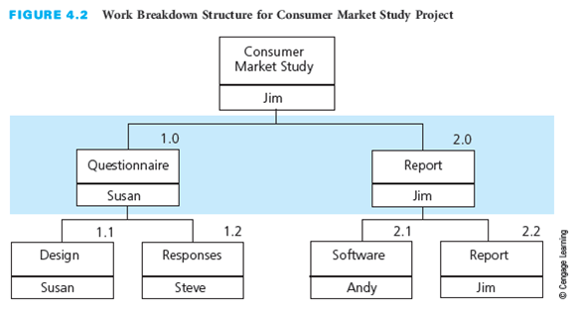
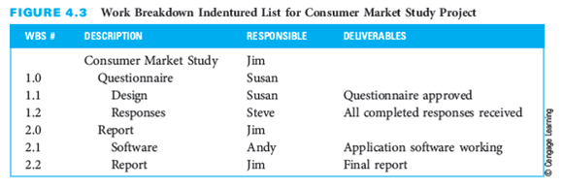
WBS
Graphic Chart
Indentured List
Notes:
WBS
The top figure depicts the WBS for the consumer market study project example. This project is also the example used in the Microsoft Project appendices.
Have students examine the relationship between this figure and the entries in the Microsoft Project task list.
The bottom figure depicts an indentured list for the work breakdown structure.
For each of the work packages, the deliverable is listed.
This format is helpful for large projects where a diagram would become too large and unwieldy.

Slide 11
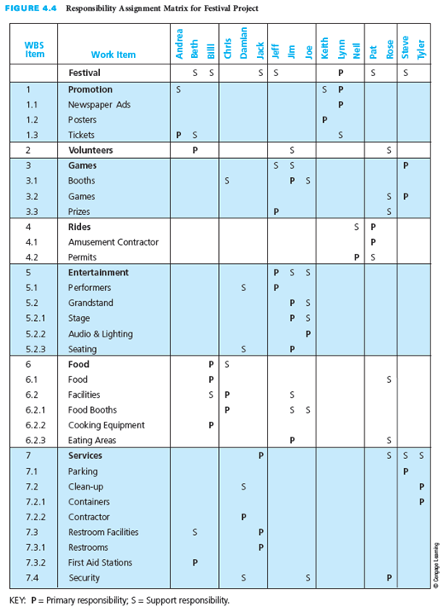
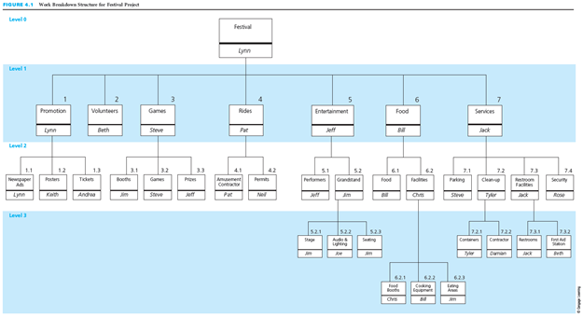
Assign Responsibility
Responsibility assignment matrix
Designate responsible individuals
P = Primary responsibility
S = Support responsibility
Associates responsibility
For each work item
For each individual
Only one primary per work item
Notes:
Assign Responsibility
A responsibility assignment matrix (RAM) defines who will be responsible for the work. It is a tool used to designate the individuals responsible for accomplishing the different work items in the work breakdown structure (WBS).
This figure depicts the RAM for the WBS in Figure 4.1, the community festival project.
The RAM often uses a P to designate primary responsibility and an S to indicate support responsibility for a specific work item.
The RAM shows all the individuals associated with each work item in the WBS, as well as all the work items associated with each individual.
Only one individual should be designated as the lead, or primary, person responsible for each work item.

Slide 12
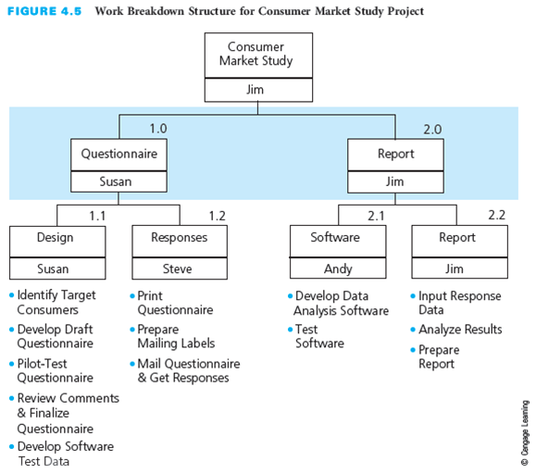
Define Activities
Responsible resources define activities
Breakdown work packages to work items
Level needed to perform deliverable
May not be able to define all
Comprehensive activity list
Not always require expenditure of effort
Could be wait time
Notes:
Define Activities
Using the WBS, the individual or team responsible for each work package must next define all the specific activities that need to be performed to produce the end item, or deliverable.
Breaking down each work package into its component activities reveals the level at which each activity must be performed to produce the deliverable.
Some activities may not be easily definable.
When all the specific activities have been defined for all of the work packages, they should be consolidated into a comprehensive activity list.
Because of the allocation of resources, there may be wait time between the end of one activity and the start of another one.
This figure shows the work breakdown structure for a consumer market study project. It depicts the specific activities that need to be performed for each work package.
Have the students compare this list to the entries for the tasks in the Microsoft Project appendix.

Slide 13
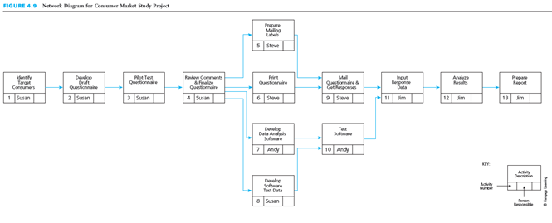
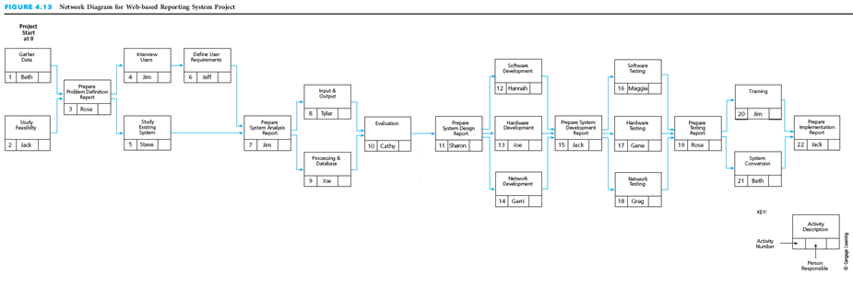
Sequence Activities
Network diagram
Defines the sequence of activities and relationships
Tool for arranging order
Common techniques
PERT
CPM
PDM
Notes:
Sequence Activities
A network diagram defines the sequence of how the activities will get done. It is a tool for arranging the specific activities in the best sequence and defining their dependent relationships.
The three most common techniques of network diagramming are program evaluation and review technique (PERT), the critical path method (CPM), and the precedence diagramming method (PDM).
In the past, there were distinguishable methodological differences between PERT and CPM. Today, however, when most people refer to a CPM diagram or PERT chart, they mean a generic network diagram.
The top figure shows a complete network diagram for a consumer market study project, with the person responsible for each activity included on the diagram.
The bottom figure shows a network diagram for a web-based reporting system project.

Slide 14


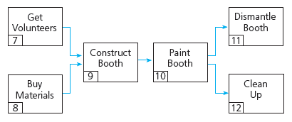
Network Principles
Activities
Represented by a box
Consume time
Described by verb
Relationships
Linked in serial sequence
Complete concurrently
Notes:
Network Principles
Each activity is represented by a box in the network diagram and the description of the activity is written within the box, as shown in this figure.
Activities consume time, and their description usually begins with a verb (such as get, wash, and dry in this example).
Activities have a dependent relationship—that is, they are linked in a logical sequence in a network diagram to show which activities must be finished before others can start.
Certain activities have to be done in serial sequence.
Some activities may be done concurrently.

Slide 15
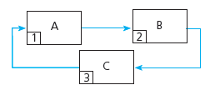
Loops
Illogical relationship among activities
Perpetually repeats itself
Not acceptable
Notes:
Loops
An illogical relationship among activities is known as a loop.
In preparing a network diagram, drawing activities in a loop is not acceptable because it portrays a path of activities that perpetually repeats itself.

Slide 16

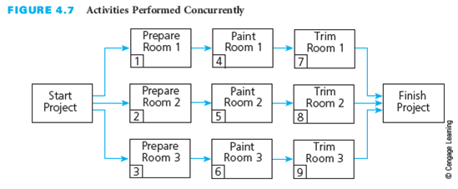
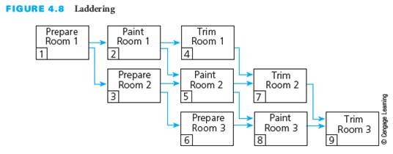
Laddering
Set of repeating activities
Serial sequence
One work
Two wait
Can be performed at same time
Would need triple resources
Ladder activities
Allow for shortest possible time for completion
Best use of the three workers and experts
Notes:
Laddering
Some projects have a set of activities that are repeated several times.
The top figure shows a series of activities that must be done in serial sequence, which means that, for an activity with three people, at any one time only one person is working while two other people are waiting.
The middle figure shows a set of activities that can be performed concurrently. However, it is often not practical to perform the activities in this way because the organization would need triple the experts– one for each room.
The bottom figure shows a technique known as laddering. This approach allows the project to be completed in the shortest possible time, while making the best use of available resources.

Slide 17
Create Network Diagram
Tips and Techniques
Development of Diagram
Logical sequence of activities
Show dependent relationships
Elaborate as project progresses
Use subnetworks for similar activity sequences and relationships
Questions to answer
Finish before next start?
Done concurrently?
Cannot be started next?
Guidelines for detail level
Define each work package
Draw summary level network then add detail
Detail to responsibility or deliverable change
Duration less than project progress review
Notes:
Create Network Diagram
A network diagram is a drawing of the activities for a project, displayed in boxes in their logical sequence and connected by arrows to indicate dependent relationships. The network diagram shows how the project should be performed from start to completion.
Three questions need to be answered regarding each activity. The network is based upon the answers:
Which activities must be finished immediately before this activity can be started?
Which activities can be done concurrently with this activity?
Which activities cannot be started until immediately after this activity is finished?
Guidelines for the level of detail in the network diagram are:
Based on the work breakdown structure for a project; specific activities should be defined for each work package.
It may be preferable to draw a summary-level network first that depicts a small number of higher level activities and then expand to a more detailed network.
The level of detail may be determined by certain obvious interface or transfer points such as a change in responsibility or if there is a tangible output or product or deliverable as a result of an activity.
Activities should not be longer in estimated duration than the project progress review.
It is not unusual to progressively elaborate the network diagram as the project progresses and more information becomes clear.
Sub-networks can be used to represent similar projects for different customers. Certain portions of projects may include the same types of activities in the same sequence and with the same dependent relationships.

Slide 18
Planning for Information Systems Development
Definition
Process
Computer-based system
Accepts data as input
Processes the data
Produces useful information
Examples
Computerized order entry
E-commerce
Automatic teller machines
Billing, payroll, and inventory
Plan, execute, and control
Systems Development Life Cycle
Problem definition
System analysis
System design
System development
System testing
System implementation
Notes:
Planning for Information Systems Development
The Microsoft Project example will continue through chapters 4 – 8. It highlights the concepts for each chapter in the example. The Microsoft Project file for the example is available with the instructor materials.
An information system (IS) is a computer-based system that accepts data as input, processes the data, and produces useful information for users.
Information systems include computerized order entry systems, e-commerce systems, automatic teller machines, and billing, payroll, and inventory systems.
The development of an IS is a challenging process that requires extensive planning and control to ensure that the system meets user requirements and is finished on time and within budget.
A project management planning tool, or methodology, called the systems development life cycle (SDLC) is often used to help plan, execute, and control IS development projects.
It consists of the following steps:
Problem definition -- Data are gathered and analyzed and problems and opportunities are clearly defined.
System analysis -- The development team defines the scope of the system to be developed, interviews potential users, studies the existing system (which might be manual), and defines user requirements.
System design -- Several alternative conceptual designs are produced and evaluated. The best is selected for further design and development.
System development -- The actual system is brought into existence.
System testing – This step involves looking for logical errors, database errors, errors of omission, security errors, and other problems that might prevent the system from being successful.
System implementation -- The existing system is replaced with the new, improved, system and users are trained.

Slide 19
An IS Example: Internet Applications Development for ABC Office Designs
ABC Office Designs
Project
Large number of sales representatives
Sell office furniture to major corporations
State assignments in four regions
Management monitor state and regional sales
Build Web-based IS system to track prices, inventory, and competition
Project manager identified
WBS follows SDLC
Responsibility assignment matrix completed
List of tasks compiled and predecessors identified
Network diagram created
Notes:
An IS Example: Internet Applications Development for ABC Office Designs
A corporation called ABC Office Designs has a large number of sales representatives who sell office furniture to major corporations. Each sales representative is assigned to a specific state, and each state belongs to one of four regions in the country.
To enable management to monitor the number and amount of sales for each representative, for each state, and for each region, ABC has decided to build a Web-based information system that will track prices, inventory, and the competition.
The IS department within the corporation has assigned Beth Smith to be the project manager of the Web-based reporting system development project.
The following four slides depict figures related to this project.
First, we will see the major tasks that were identified for the project.
Then we will look at the responsibility assignment matrix for the project with the primary and secondary responsibilities for each task assigned.
We will then look at a list of all tasks to be done, with the immediate predecessor for each task listed to the right of the task.
Finally, we will examine the network diagram created by Beth and the project team that represents the interdependencies listed in the immediate predecessor list.

Slide 20
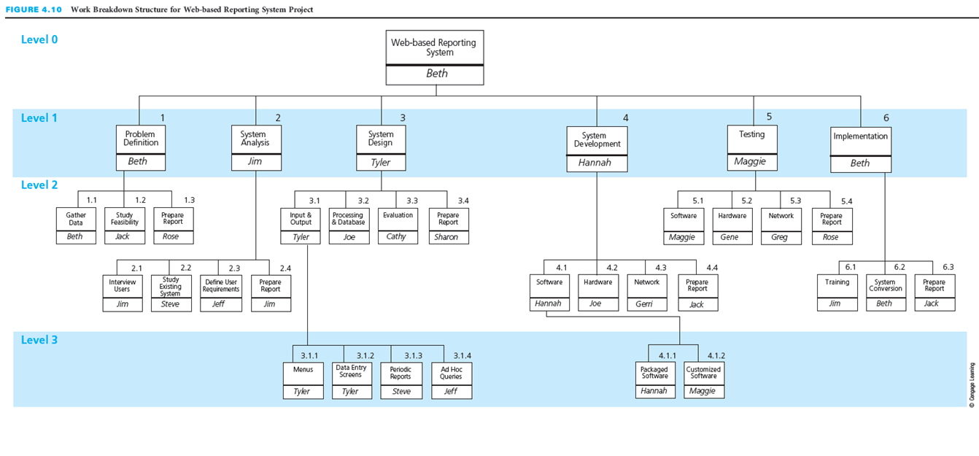
IS Example: WBS follows SDLC
Notes:
IS Example: WBS follows SDLC
This figure depicts the major tasks that were identified for the project. The WBS follows the SDLC.

Slide 21
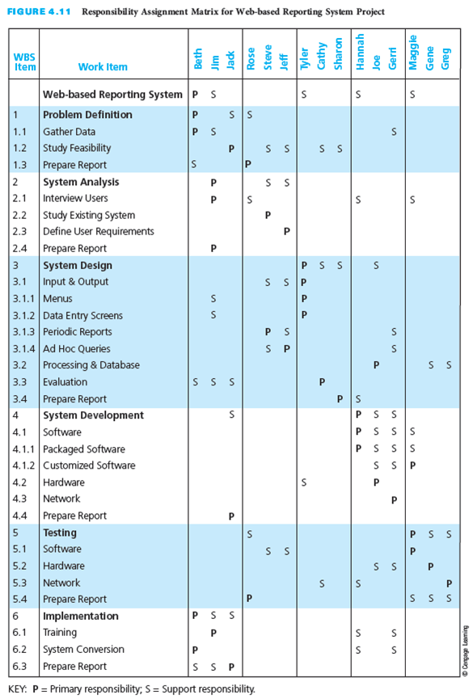
IS Example: Responsibility Assignment Matrix
Notes:
IS Example: Responsibility Assignment Matrix
Here we see the responsibility assignment matrix for the project, with the primary and secondary responsibilities for each task assigned.
Make sure that students note that all the tasks in the WBS appear in the responsibility assignment matrix.

Slide 22
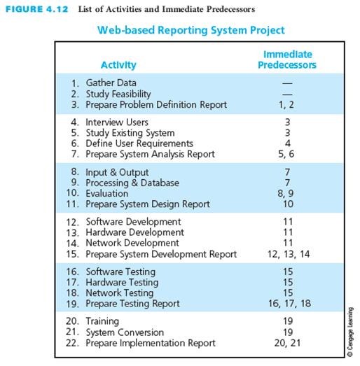
IS Example: Task List and Predecessors
Notes:
IS Example: Task List and Predecessors
This figure depicts a list of all tasks to be completed, with the immediate predecessor for each task listed to the right of the task.
Have the students examine the interdependencies of the tasks.

Slide 23
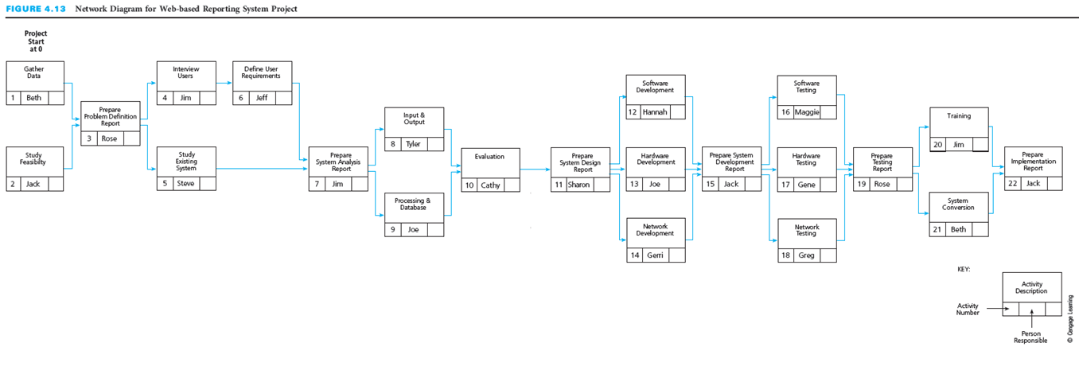
IS Example: Network Diagram
Notes:
IS Example: Network Diagram
Here is the network diagram created by Beth and the project team.
This figure represents the interdependencies listed in the immediate predecessor list.

Slide 24
Project Management Information Systems
Wide variety of systems available
Plan and control projects in interactive mode
Plan and test different options
Create reports, diagrams, and charts
Interface with other software applications
Appendix A has additional information
Notes:
Project Management Information Systems
A wide variety of affordable project management information systems are available for purchase.
These systems allow the project manager and the project team to plan and control projects in a completely interactive mode.
Planning and testing different options for task durations, dependencies, constraints, resources, schedules, and costs can be completed in a project management information system.
Information systems help project managers to create reports, change management, network diagrams, and Gantt charts.
Project management information systems also interface with other software applications.
Appendix A contains information related to project management information systems.

Slide 25
Critical Success Factors
Plan the work and then work the plan. It is important to develop a plan before starting to perform the project. Taking the time to develop a well-thought-out plan is critical to the successful accomplishment of any project.
Participation builds commitment. By participating in the planning of the work, individuals will become committed to accomplishing it according to the plan.
The project must have a clear objective of what is to be accomplished. The objective should be defined in terms of end product or deliverable, schedule, and budget, and it must be agreed upon by the customer and the project team that will perform the project.
The project scope document is valuable for establishing a common understanding and agreement among project stakeholders regarding the scope of the project.
Having a quality plan at the outset of the project is extremely beneficial because it will help prevent incurring additional costs and schedule extensions due to rework caused by work and deliverables that fail to meet quality requirements and customer expectations.
The key to quality control is to monitor the quality of the work early and regularly throughout the performance of the project, rather than waiting until all the work is completed before checking or inspecting for quality.
The network diagram is also is a communication tool for the project team because it shows who is responsible for each activity and how each person’s work fits into the overall project.
Notes:
Critical Success Factors
Plan the work and then work the plan. It is important to develop a plan before starting to perform the project. Taking the time to develop a well-thought-out plan is critical to the successful accomplishment of any project.
Participation builds commitment. By participating in the planning of the work, individuals will become committed to accomplishing it according to the plan.
The project must have a clear objective of what is to be accomplished. The objective should be defined in terms of end product or deliverable, schedule, and budget, and it must be agreed upon by the customer and the project team that will perform the project.
The project scope document is valuable for establishing a common understanding and agreement among project stakeholders regarding the scope of the project.
Having a quality plan at the outset of the project is extremely beneficial because it will help prevent incurring additional costs and schedule extensions due to rework caused by work and deliverables that fail to meet quality requirements and customer expectations.
The key to quality control is to monitor the quality of the work early and regularly throughout the performance of the project, rather than waiting until all the work is completed before checking or inspecting for quality.
The network diagram is also is a communication tool for the project team because it shows who is responsible for each activity and how each person’s work fits into the overall project.

Slide 26
Summary
The planning process is based on the project objective, which establishes what is to be accomplished.
The project scope defines what needs to be done.
The project scope document usually contains the customer requirements, statement of work, deliverables, acceptance criteria, and a work breakdown structure.
The quality plan must include or reference the specifications, industry or government standards, and codes that must be used and met during the performance of the project work.
The work breakdown structure establishes the framework for how the work will get done to produce the project deliverables.
A responsibility assignment matrix defines who will be responsible for the work.
Activities define more specifically how the work will get done.
A network diagram defines the sequence of how and when the activities will be performed.
Project planning is a critical activity in developing an information system (IS).
A project management planning tool or methodology, called the systems development life cycle (SDLC), is often used to help plan, execute, and control IS development projects.
Numerous project management information systems are available to help project managers plan, track, and control projects in a completely interactive way.
Notes:
Summary
The planning process is based on the project objective, which establishes what is to be accomplished.
The project scope defines what needs to be done.
The project scope document usually contains the customer requirements, statement of work, deliverables, acceptance criteria, and a work breakdown structure.
The quality plan must include or reference the specifications, industry or government standards, and codes that must be used and met during the performance of the project work.
The work breakdown structure establishes the framework for how the work will get done to produce the project deliverables.
A responsibility assignment matrix defines who will be responsible for the work.
Activities define more specifically how the work will get done.
A network diagram defines the sequence of how and when the activities will be performed.
Project planning is a critical activity in developing an information system (IS).
A project management planning tool or methodology, called the systems development life cycle (SDLC), is often used to help plan, execute, and control IS development projects.
Numerous project management information systems are available to help project managers plan, track, and control projects in a completely interactive way.

